Slide 1
Discrete Mathematics
South China University of Technology
1

Slide 2
Chapter 8. Graphs
Graph Terminology
Section 8.2
2

Slide 3
Contents
1
Basic Terminology
2
Some Special Simple Graphs
3
Bipartite Graphs
4
Some Application of Special Types
3

Slide 4
Basic Terminology
4

Slide 5
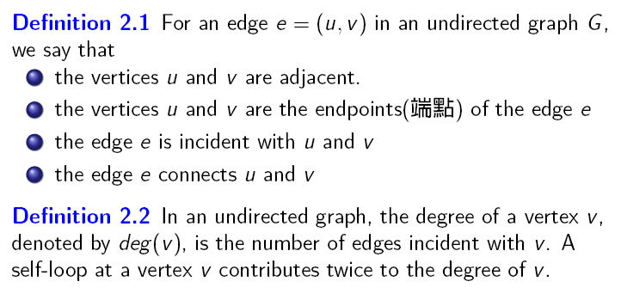

Slide 6
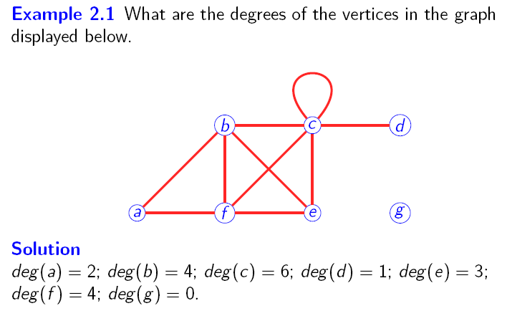

Slide 7



Slide 8




THEOREM: An undirected graph has an even number of vertices of odd degree.

Slide 9
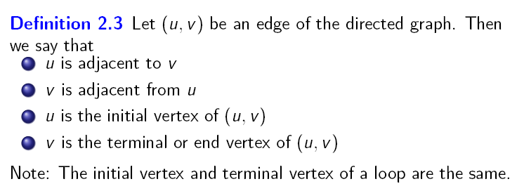

Slide 10




Slide 11
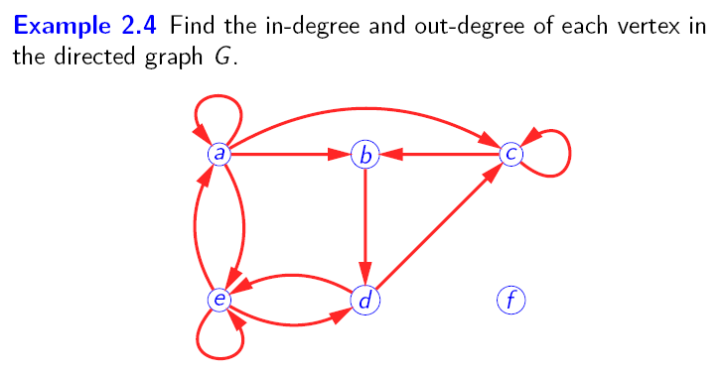


Slide 12
Some Special Simple Graphs
12

Slide 13
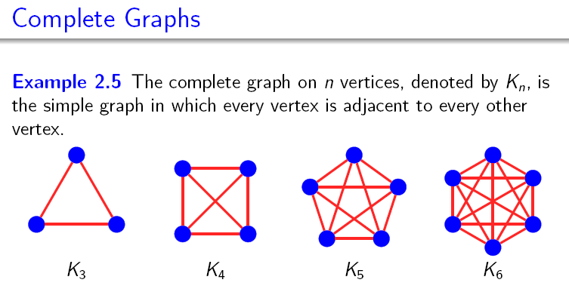

Slide 14
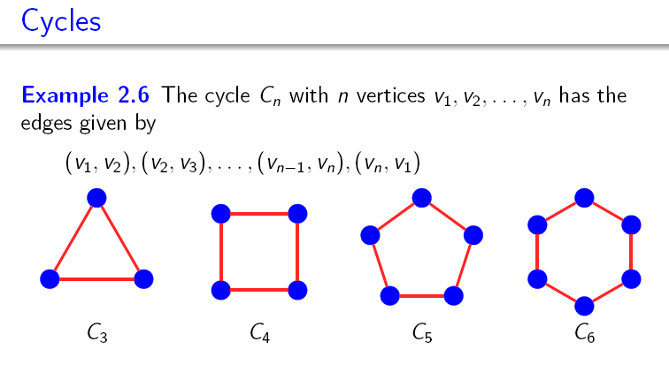

Slide 15
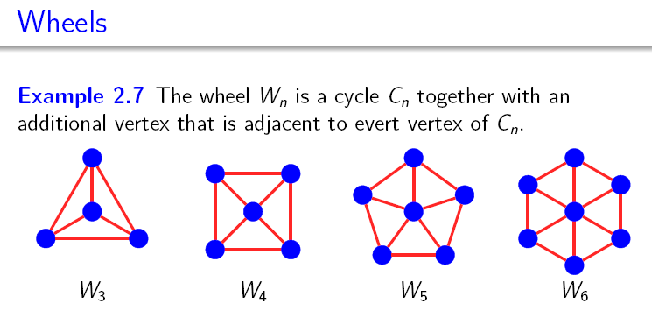

Slide 16
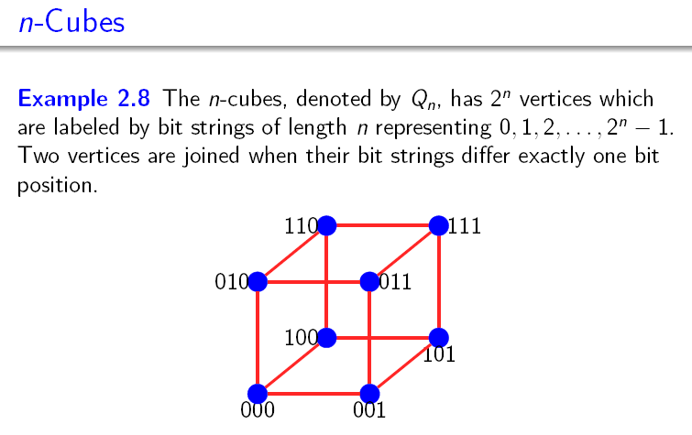

Slide 17
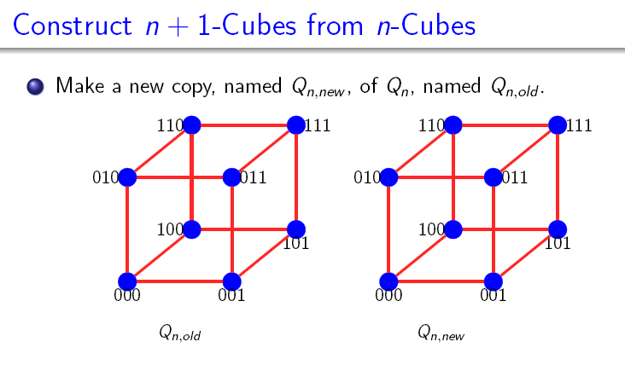

Slide 18
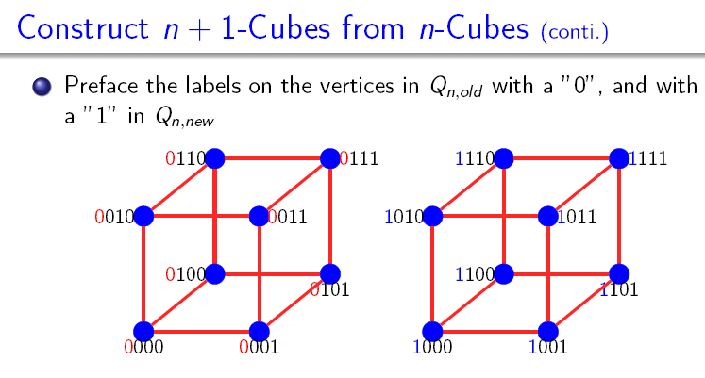

Slide 19
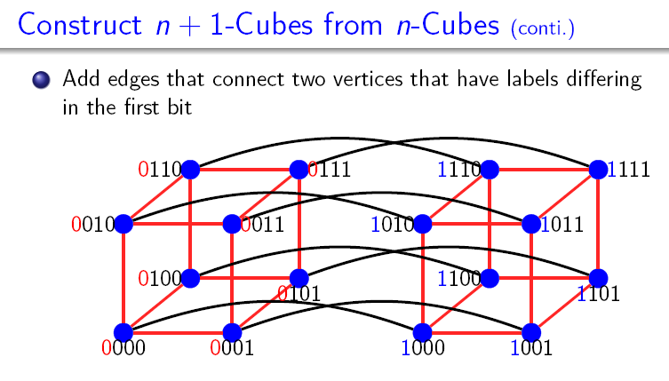

Slide 20
Bipartite Graphs
20

Slide 21

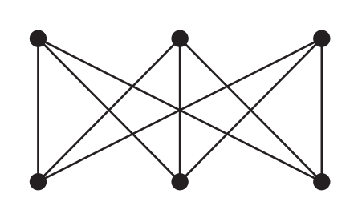
Bipartite graph

Slide 22
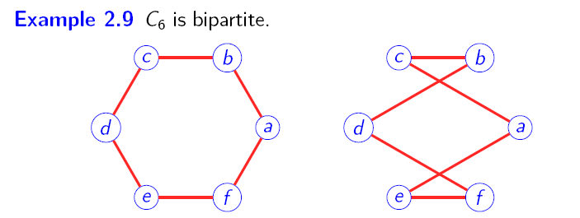

Bipartite graph

Slide 23
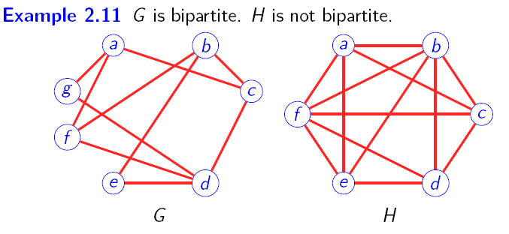
Bipartite graph

Slide 24

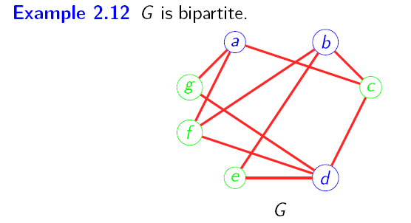
Bipartite graph

Slide 25
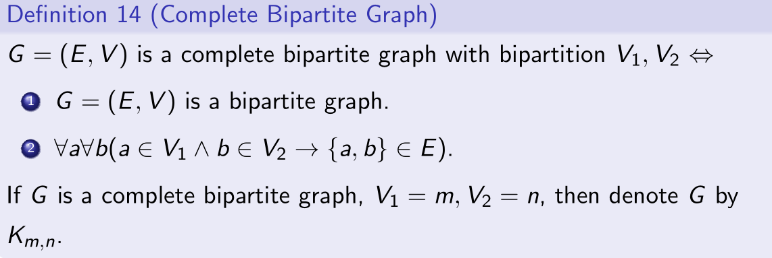
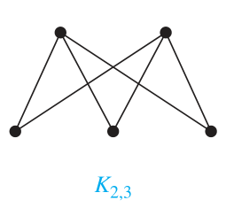
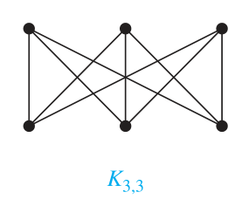
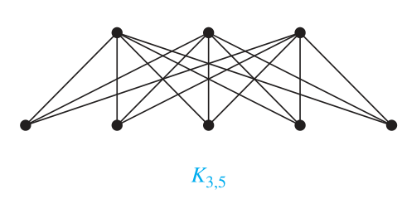
Bipartite graph

Slide 26

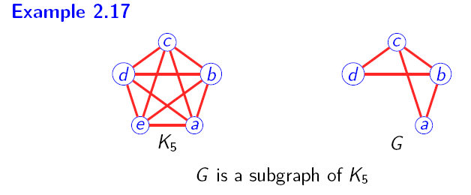

Slide 27



Slide 28
历史上的考题
Question: How many edges in Qn ?

Slide 29


Slide 30
Homework
2, 8, 24,26

Slide 31
End of Section 8.2
Click to edit company slogan .
31

